Slide 1
Example of Polls in Science/IT Subjects These polls only illustrate some possible ways to show the polls to students. There are no actual answers available to these questions.

Slide 2
Questions from UCSD Teaching and Learning Commons
You may want to watch the following video on the explanation of the following slides
UCSD Teaching and Learning Commons

Slide 3
How many times is “foo” printed?
for (int i = 0; i < 10; i++)
{
System.out.printIn(“foo”);
}
Write out on board (cheerleader questioning)
Pose several variations on a slide
Code live
Problem: The teacher is the one doing the work!

Slide 4
A possible poll
How many times is “foo” printed?
for (int i = 0; i < 10; i++)
{
System.out.printIn(“foo”);
}
0
10
9
11
None of the above
Problem: Doesn’t encourage discussion!

Slide 5
A better poll
Which of the following loop headers will cause the loop to run 10 times?
for (int j = 0; j < 10; j++)
for (int j = 0; j <= 10; j++)
for (int j = 1; j < 10; j++)
for (int j = 1; j <= 10; j++)
Better Because:
2 answers correct
Allows me draw their attention to 3 important things about for loops
There’s something to talk about!

Slide 6
Questions from the Carl Wieman Science Education Initiative
You may want to visit the website at the University of British Columbia for more useful resources on Student Response Systems (i.e. Clickers)
www.cwsei.ubc.ca/SEI_research

Slide 7
Example: Graphical Question
A ball is rolling around the inside of a circular track. The ball leaves the track at point P. Which path does the ball follow?
C
B
D
A
E
P

Slide 8
Example: Photo Question
If this is the phase of the Moon when it rises:
what is the phase of the Moon 12 hours later?
A
B
C
D
E

Slide 9
Example: Graphical Answer
Susan throws a ball straight up into the air. It goes up and then falls back into her hand 2 seconds later.
Draw a graph showing the velocity of the ball from the moment it leaves her hand until she catches it again.
velocity
time
0
2 sec

Slide 10
Which one is the closest match to your graph?
velocity
velocity
A
B
time
time
0
2 sec
0
2 sec
velocity
velocity
C
D
time
time
0
2 sec
0
2 sec
E) some other graph

Slide 11
Example: Graphical Answer
John is walking to school. This graph shows his position as a function of time. When is John moving with the greatest velocity?
position
time
A
B
C
D
E

Slide 12
Example: Equation
Which of the following is an incorrect step when using the substitution method to evaluate the definite integral?
none of the above

Slide 13
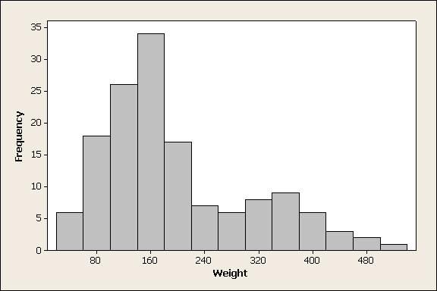
Example: Statistics
For the data set displayed in the following histogram, which would be larger, the mean or the median?
mean
median
can’t tell from the given histogram
(Peck, mathquest.carroll.edu/resources.html)

Slide 14
Example Question
Consider a block of wood that has varying dimensions. Does the pressure exerted on the table from the block depend on the blocks position? If so, which way produces the greatest pressure? If not, why not?
A)
B)
C)
D) The block of wood has the same density, so it doesn’t matter which way it is positioned.
E) The block of wood has the same mass, so it doesn’t matter which way it is positioned.
Notes:
14

Slide 15
Example question on Seasons
What causes the seasons?
The change in the earth's distance from the sun during the year
The tilt of the earths axis
Changes in the sun's brightness
Change in clouds
None of the above

Slide 16
Better Example question on Seasons
What would happen to the seasons if the earth's orbit around the sun was made a perfect circle
There would be no seasons
The seasons would remain pretty much as they are today
Winter to spring would differ much less than now
Winter to spring would differ much more than now

Slide 17
Example Question
A small acorn over time can grow into a huge oak tree. The wood in such tree can weigh many tons, even after it has been cut into logs and dried.
Where does most of this mass come from as the tree grows?
Minerals in the soil
Organic matter in the soil
Gases in the air
Sunlight

Slide 18
Example Question
How do plants use the oxygen gas that they release as a waste product of photosynthesis?
Oxygen gas is used to build more sugar in chloroplasts
Oxygen is a direct source of energy for plants
Oxygen is primarily released for animals to use in cellular respiration
Oxygen is required for ATP production in the mitochondria of plants
Oxygen isn’t used for anything by plants

Slide 19
Example question
Suppose you pass white light through a prism and all of the colours of the spectrum are projected on a screen. If you then put a red filter over your eye and look at the spectrum, what colours do you see?
you see mostly red light; the blue and green disappears
you see mostly blue light; the other colours disappear
all of the colours turn red

Slide 20
Example question
To minimize the work you do getting a heavy bag of groceries from the first floor to the second floor of a building, you should
carry the bag up the stairs
carry the bag up in an elevator
put the bag on the floor of an elevator, ride up with it, and then pick up the bag again
carry the bag up a ramp
put the bag in a cart and push it up a ramp

Slide 21
Example question
Can your eyes resolve things better at night or during the day?
you can resolve things better at night
you can resolve things better during the day
you can resolve things the same during the day and at night

Slide 22
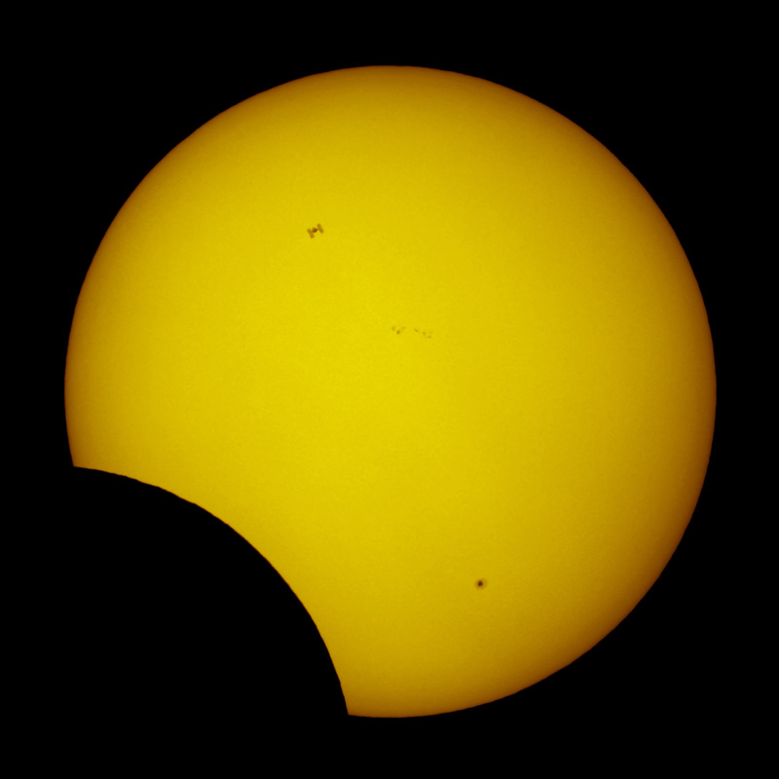
What do you think is most interesting about this picture?
lunar eclipse
solar eclipse
cloud blocking the Sun
sunspots
other
Astronomy Picture of the Day 2011 January 5

Slide 23
Example question
String 1 has a linear mass-density of 3.00 g/cm and string 2 has a linear mass density of 5.00 g/cm. They are under tension due to a hanging block of mass M = 500 g. (a) Calculate the wave speed in each string.
Which equation sets up the problem correctly?
1
2
T₁ + T₂ = mg, where T1≠ T2
T₁ - T₂ = mg, where T1≠ T
2T = mg
2T = -mg
choices C & D are correct because we are only concerned with magnitude
M
Notes:
Sort of all over – this was helpful to get the students on the right track, so that they could move forward and answer (b). Also, students kept asking don’t they need the length and mass, apparently giving them ‘linear mass-density’ was too vague. Probably want to include ‘mu’.

Slide 24
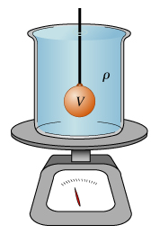
If you lower a 1.5 kg mass on a string into a 5 kg beaker filled with water, what happens to the reading on the scale?
increases to 6.5 kg
increases to a value < 6.5 kg
increases to a value > 6.5 kg
stay the same

Slide 25
Prediction
An ice cube is floating in a glass of water that is filled entirely to the brim. As the ice cube melts, the water level will
A. stay the same, remain at the brim.
B. rise, causing the water to spill.
C. fall to a level below the brim.
D. cannot say without knowing the
density of ice.
Notes:
STT15.4

Slide 26
The End

